Slide 1
Cloud Systems

Slide 2
Introduction
A cloud storage system, consisting of a collection of storage servers, provides long-term storage services over the Internet. Storing data in a third party’s cloud system causes serious concern over data confidentiality.
General encryption schemes protect data confidentiality, but also limit the functionality of the storage system because a few operations are supported over encrypted data Cloud storage is defined as "the storage of data online in the cloud," wherein a individual's data is stored in and accessible from multiple distributed and connected resources that comprise a cloud.
Cloud storage can provide the benefits of greater accessibility and reliability; rapid deployment; strong protection for data backup, archival and disaster recovery purposes; and lower overall storage costs as a result of not having to purchase, manage and maintain expensive hardware.
There are many benefits to using cloud storage, however, cloud storage does have the potential for security and compliance concerns that are not associated with traditional storage system.

Slide 3
Objective
Main objective:
The major objective is to develop an operational Online Cloud storage system .
Specific Objective:
To Store Data Online.
User can store and download data from website.
User can view File details and can add other files like .doc, .pdf and etc.
User can view the overall report through generated pie charts from the given details.
Helps user to search files.
It is easy to use and understand.
Encryption.
Share a files.
Chats with other users.
Graph Reports.

Slide 4
Scope of the Project
Designing a cloud storage system for robustness, confidentiality and functionality. This Online Storage provides a lot of services to users which includes:
Daily usage of users,
keep records about the files,
graph of usage of data,
availability of data.
We construct a secure cloud storage system that supports the function of secure data forwarding by using a threshold proxy re-encryption scheme.
The encryption scheme supports decentralized erasure codes over encrypted messages and forwarding operations over encrypted and encoded messages.
This system is highly distributed where storage servers independently encode and forward messages and key servers independently perform partial decryption.

Slide 5
Existing System
In Existing System we use a straightforward integration method. In straightforward integration method Storing data in a third party’s cloud system causes serious concern on data confidentiality. In order to provide strong confidentiality for messages in storage servers, a user can encrypt messages by a cryptographic method before applying an erasure code method to encode and store messages. When he wants to use a message, he needs to retrieve the
Codeword symbols from storage servers, decode them, and then decrypt them by using cryptographic keys.
General encryption schemes protect data confidentiality, but also limit the functionality of the storage system because a few operations are supported over encrypted data.
A decentralized architecture for storage systems offers good scalability, because a storage server can join or leave without control of a central authority.

Slide 6
Disadvantages of Existing System
The user can perform more computation and communication traffic between the user and storage servers is high.
The user has to manage his cryptographic keys otherwise the security has to be broken.
The data storing and retrieving, it is hard for storage servers to directly support other functions.

Slide 7
Proposed System
In our proposed system we address the problem of forwarding data to another user by storage servers directly under the command of the data owner.
We consider the system model that consists of distributed storage servers and key servers.
Since storing cryptographic keys in a single device is risky, a user distributes his cryptographic key to key servers that shall perform cryptographic functions on behalf of the user.
These key servers are highly protected by security mechanisms.
The distributed systems require independent servers to perform all operations.
We propose a new threshold proxy re-encryption scheme and integrate it with a secure decentralized code to form a secure distributed storage system.
The encryption scheme supports encoding operations over encrypted messages and forwarding operations over encrypted and encoded messages.

Slide 8
Advantages of Proposed System
Tight integration of encoding, encryption, and forwarding makes the storage system efficiently meet the requirements of data robustness, data confidentiality, and data forwarding.
The storage servers independently perform encoding and re-encryption process and the key servers independently perform partial decryption process.
More flexible adjustment between the number of storage servers and robustness.

Slide 9
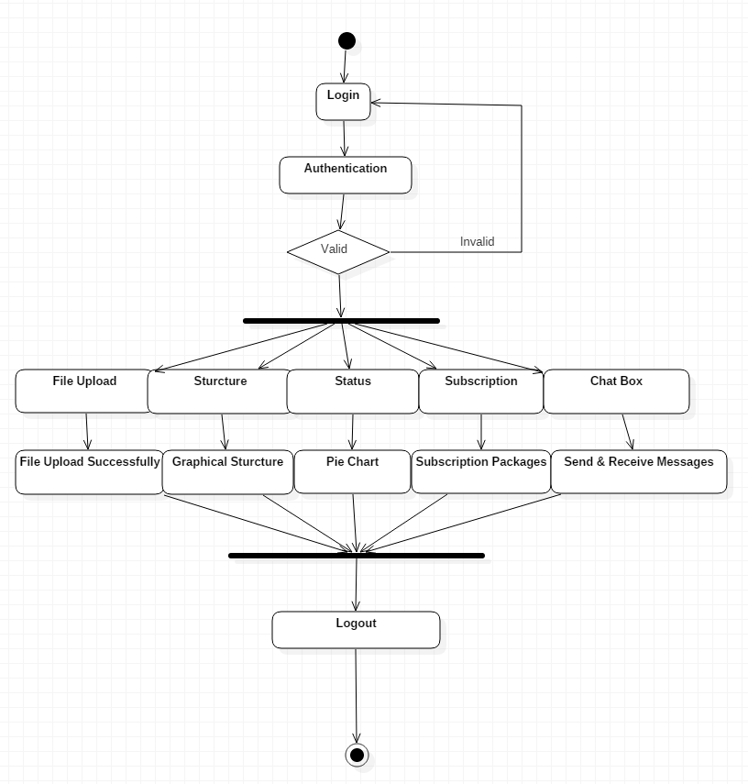
Activity Diagram

Slide 10
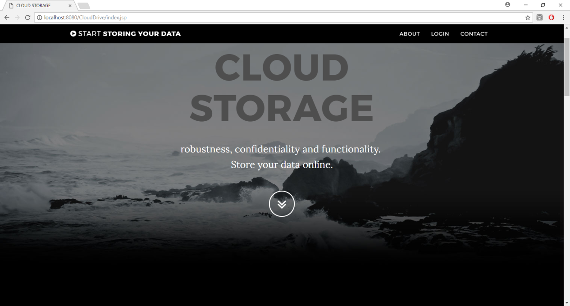
Home Page

Slide 11
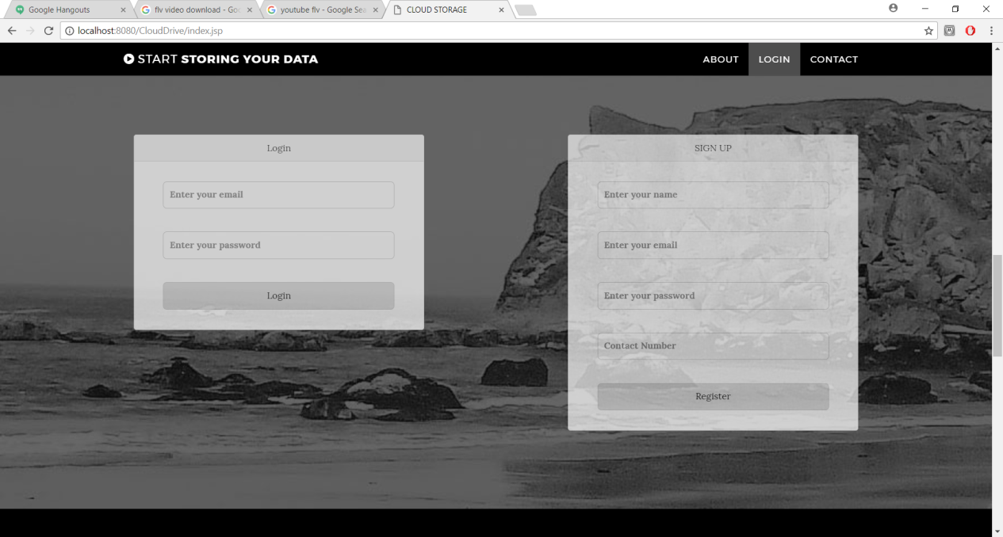
Login Page

Slide 12
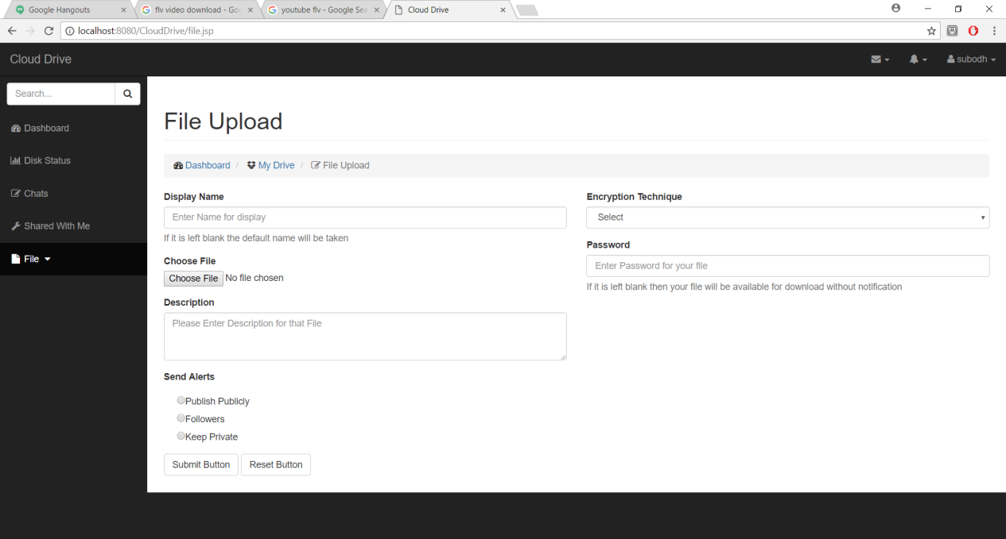
File Upload Page

Slide 13
Future Enhancement
We think that not a single project is ever considered as complete forever because our mind is always thinking new and our necessities also are growing.
Our application Also, if you see at the first glance that you find it to be complete but I want to make it still mature and fully automatic.
The system is modified in future as per the User’s requirement.
The subscription plan can be renewed by the user.
More encryption techniques could be provided.

Slide 14
Thank You

